Slide 1
Instagram User Analytics
By: Rahul Patil

Slide 2
Project Description:
User analysis is the process by which we track how users engage and interact with our digital product (software or mobile application) in an attempt to derive business insights for marketing, product & development teams.
These insights are then used by teams across the business to launch a new marketing campaign, decide on features to build for an app, track the success of the app by measuring user engagement and improve the experience altogether while helping the business grow.
In this project we are going to analyze Instagram user data which help to improve the performance of application,improve the user engagement and attract new investment.

Slide 3
Approach
To successfully carry out this project we are going to use SIX STEP of Data Analysis Process i.e (Ask,Prepare,Process,Analyze,Share,Act)
Ask step include asking right set of question which justify goal and give motivation to carry out analysis
We have following set of question (reasons ) to justify goal of this project .
Find the 5 oldest users of the Instagram from the database provided.
Find the users who have never posted a single photo on Instagram.
Identify the winner of the contest and provide their details to the team.
Identify and suggest the top 5 most commonly used hashtags on the platform
What day of the week do most users register on? Provide insights on when to schedule an ad campaign.
Provide how many times does average user posts on Instagram.
Provide data on fake and real account.

Slide 4
Approach
Prepare: We have users data store in RDBMS in different table like user,photos,likes,tags
This step include selecting right data,tools, data source to make project successful
Process: Data we have is already in process format ,i.e data store in RDBMS is process,clean and useful data.
Analyze: We are using SQL to analyze data to draw insight.
Share: Most of solution management looking for is number for each set of question,we can share result in the form of numbers likes(top 5 users,top 5 hashtag use,total real users)
Act: Step include taking decision base on insight opt from this project.

Slide 5
Tech-Stack Used
Data is stored in RDBMS (Relational Database Management System) in different table
We could use jupyter notebook and programming language to carry out this project. Which requires programming skills as well further extra step such as connecting to database,loading data from DBMS to notebook.
While RDBMS come with inbuilt data query language called SQL(Structure Query Language) which can successfully carry out entire analysis for this project.
Tech we are going to use for this project is Postgresql which is RDBMS

Slide 6
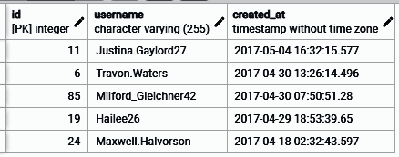
Insights
People who have been using the platform for the longest time?
Top 5 oldest user

Slide 7
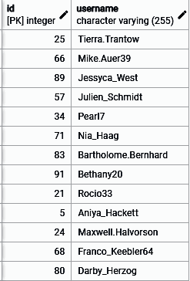
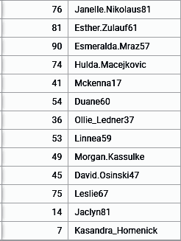
Insights
2. Remind Inactive Users to Start Posting: By sending them promotional emails to post their 1st photo?
There are 26 users who have never posted a single photo on Instagram

Slide 8
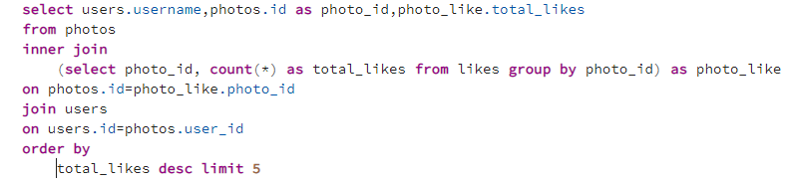
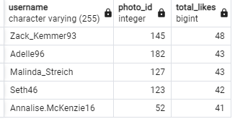
Insights
3. User who gets the most likes on a single photo will win the contest now they wish to declare the winner.
Top 5 user who gets the most likes on a single photo can be declare winner

Slide 9
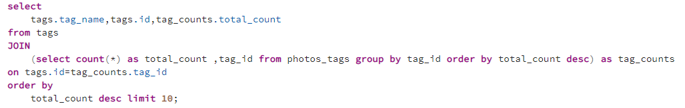
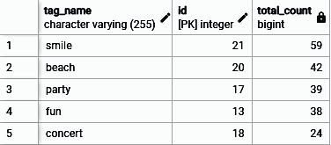
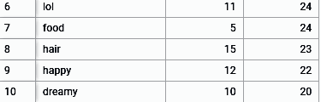
Insights
4. Which are commonly use hashtag on platform which help partner brand to reach their audience?
Above top 10 most commonly used hashtags on the platform this could help partner brand to reach their audience

Slide 10
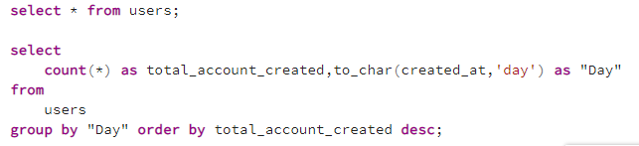
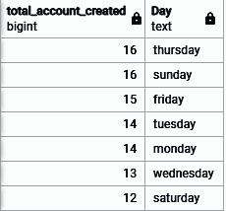
Insights
5. Which day would be the best day to launch ADs?
Most of new user added on thursday and sunday
We can use this 2 days to schedule ADs campaign

Slide 11
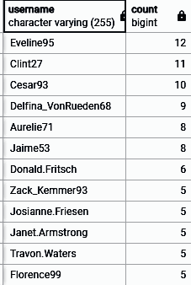


Insights
6. how many times does average user posts on Instagram.
Some user are highly active as they are posting 10-12 post.
While per user average post is 2

Slide 12
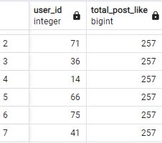
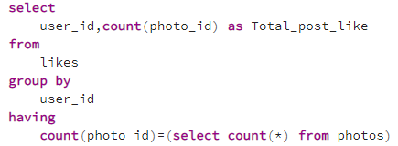
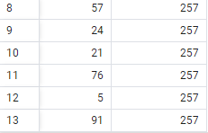
Insights
7. Provide data on real user and fake(boat) accounts.
There are 13 account who had like every single post as normal user won't do this
This is mostly a ( bots) or fake account.

Slide 13
Result
In this project we understand how to use SIX step process of Data analysis.
Project help to understand how to use SQL joins as data store in different table for simple data analytics job .
Key project insight are :
How is user engagement on platform
Thursday and sunday would be most favourable day to launch any AD campaign
There are 13 fake account out of 100 i.e 13% fake account which need to regulate using implementing new police to increase real user on platform

